Slide 1

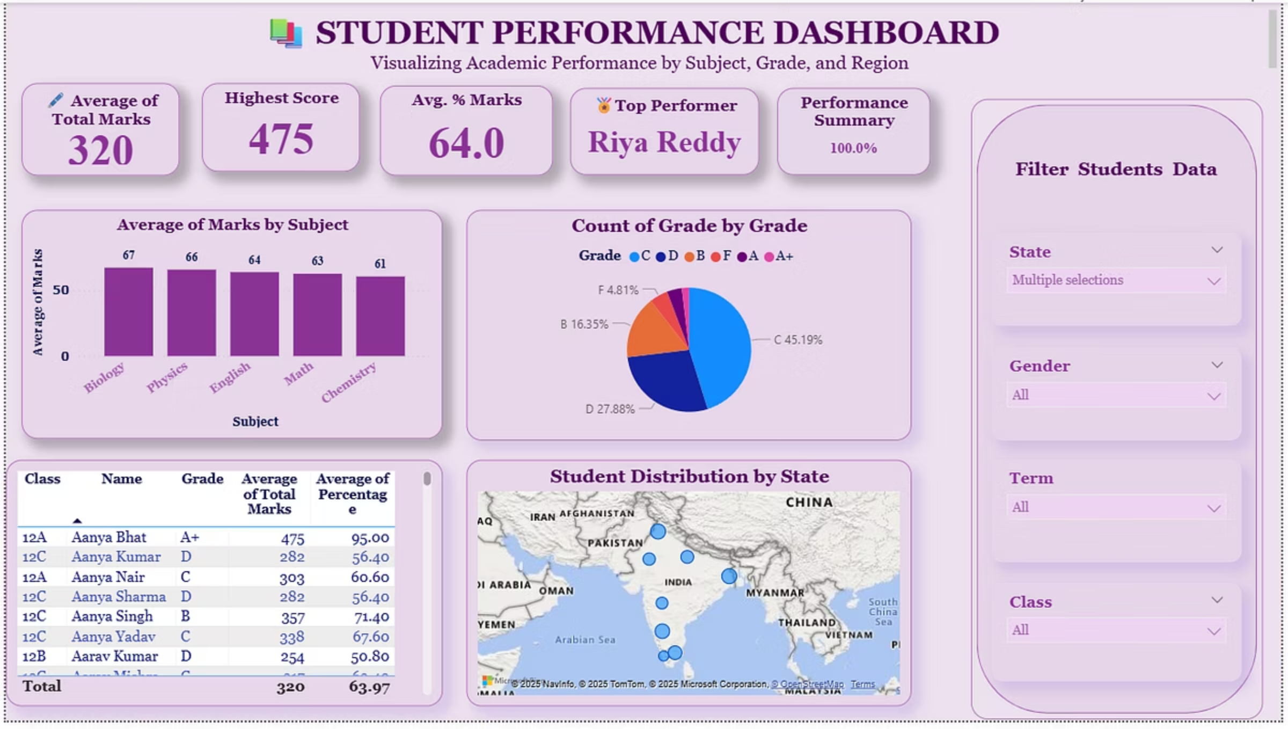
Student Performance Dashboard
Using Power BI
Presented by: [Richa Singh]
Date: [3 .08.2025]

Slide 2
Project Overview
Objective
Empower Educators
Data Source
Visualize academic performance across multiple parameters. Identify trends and top performers.
Enable data-driven decisions with interactive insights.
200 student records in CSV format.

Slide 3




Dashboard Highlights
Key features for comprehensive analysis:
Performance Metrics
Geographic View
Grade Breakdown
Subject-wise average scores for detailed insights.
State-wise distribution using a map visualization.
Grade-wise distribution via a clear pie chart.
Dynamic Filtering
Quick Insights
Slicers for Gender, Class, State, and Term.
KPIs: Average Marks, Pass %, and more.

Slide 4
Cards: Top Panel
Essential metrics for immediate oversight:
78%
98
85%
200
Average Marks
Highest Score
Pass Rate
Distinct Students
Overall academic performance indicator.
Reflects top individual achievement.
Percentage of students meeting passing criteria.
Total number of unique student records analysed.
50
States Represented
Geographical diversity of the student dataset.
DAX Example: Pass % = DIVIDE(COUNT(Passed), COUNT(StudentID))

Slide 5

Top Performer Logic
DAX formula to identify the student with the highest marks:
Top Performer = VAR MaxMarks = MAX(student_marks[Marks]) RETURN CALCULATE(MAX(student_marks[Name]), student_marks[Marks] = MaxMarks)
Visualised with a golden border and medal icon for emphasis.
This highlights individual excellence within the dataset.

Slide 6
Visualisations Utilised
Clustered Bar Chart
Subject-wise Average Marks for comparative analysis.
Pie Chart
Visual representation of Grade Distribution.
Filled Map
Geographic display of Students by State.
Filter Debug Table
Ensures accurate tracking of applied slicers.

Slide 7
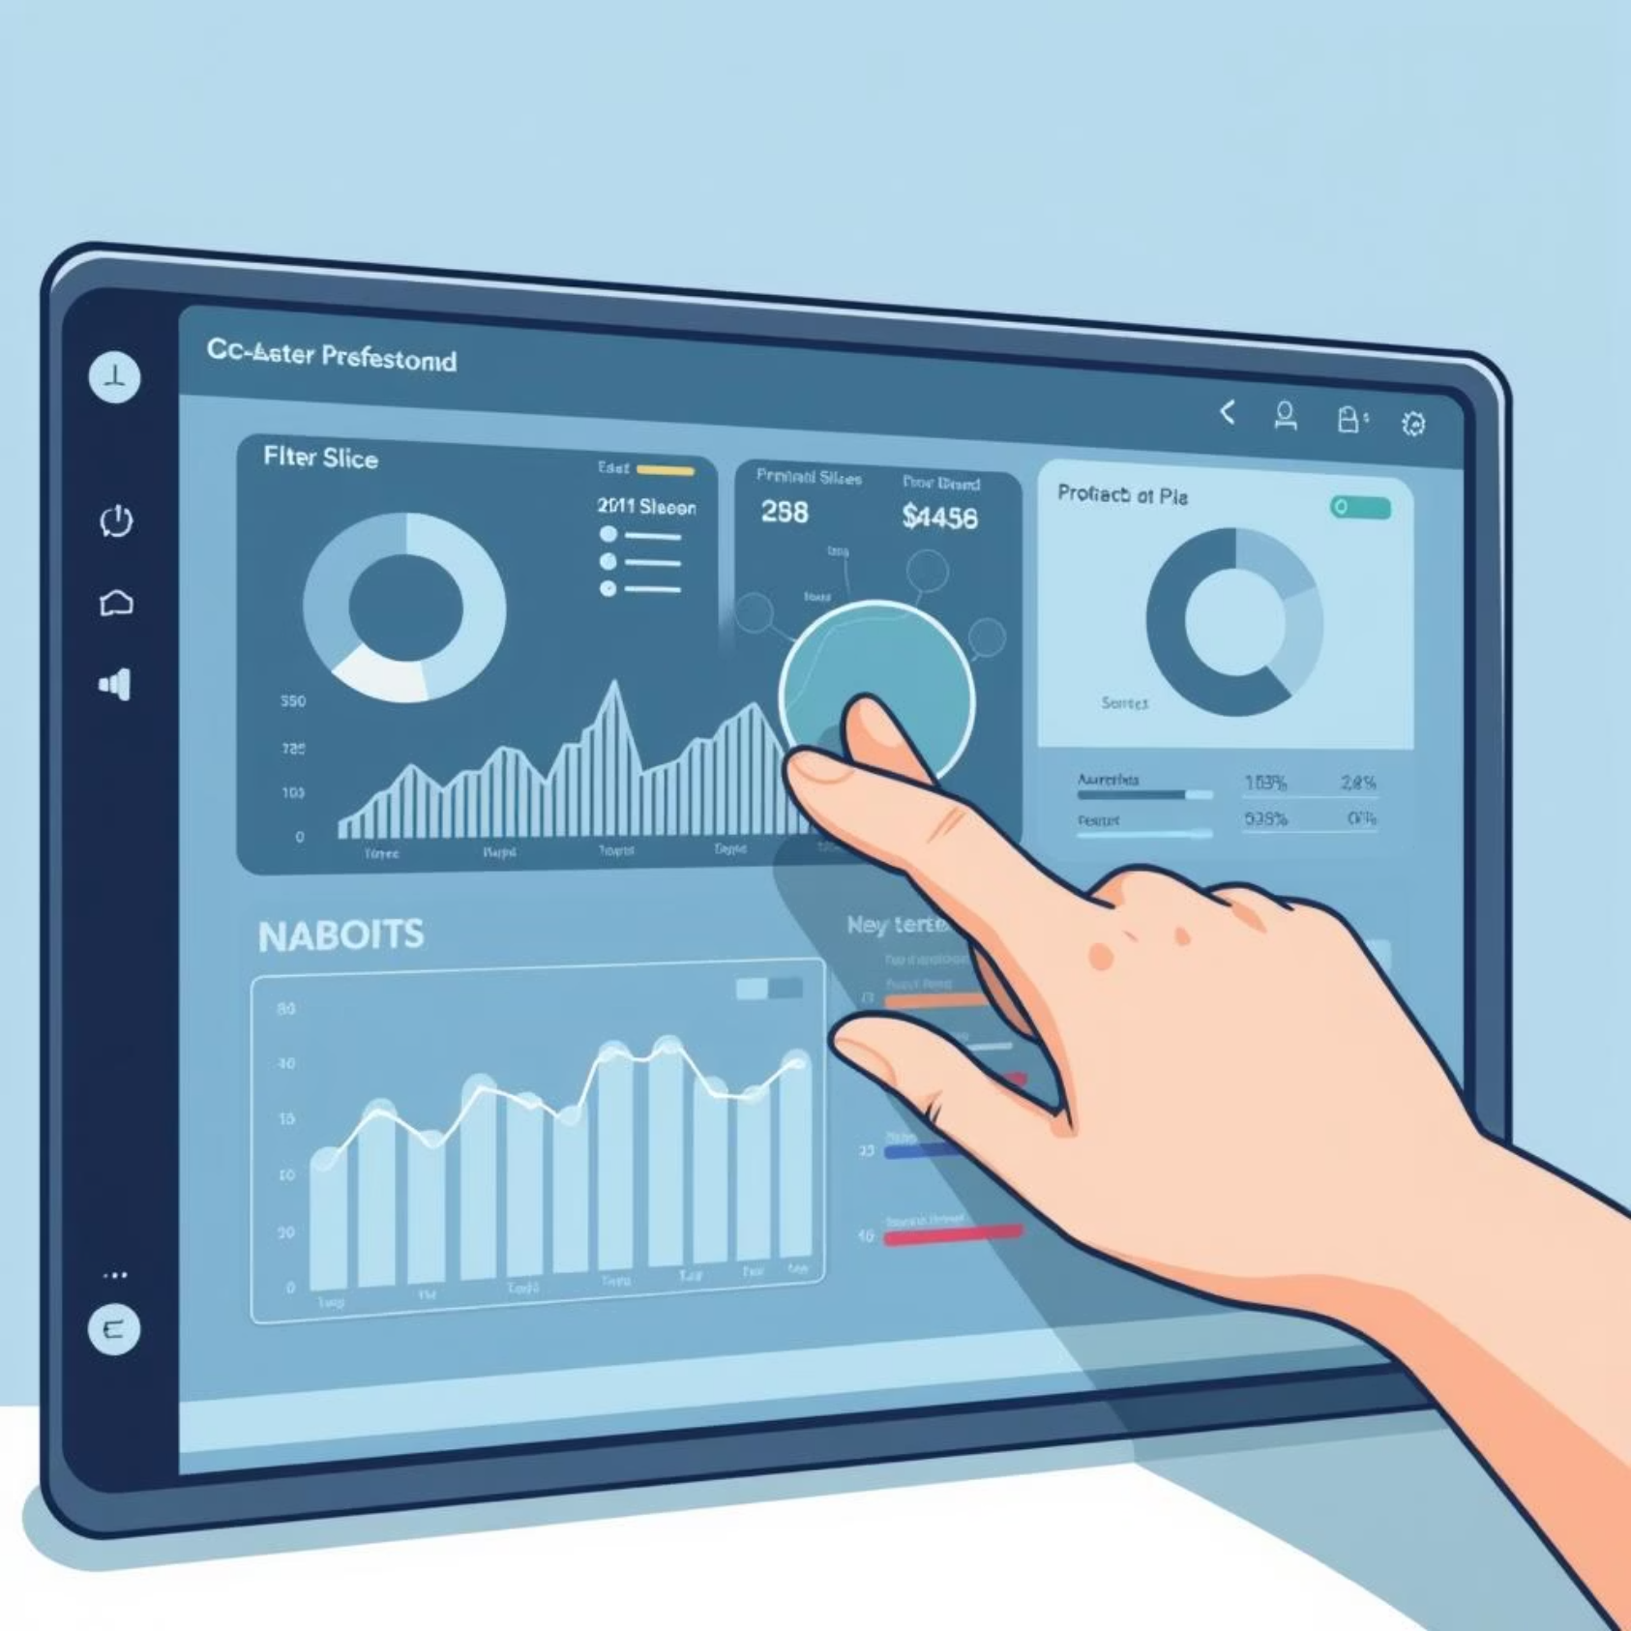
Interactivity
Dynamic Slicers
Gender
Class
Exam Term
State
Cards dynamically respond using "Filters"
Tooltips and dynamic titles enhance data clarity.

Slide 8
GitHub Folder Structure
Project repository for collaboration and sharing:
student-performance-dashboard/
├── student_marks.csv
├── Student performance dashboard.pbix
├── Dashboard_Screenshot.png
└── README.md
All files are uploaded for transparency and documentation.

Slide 9
Summary & Impact
The dashboard's core benefits:
Trend Identification
Actionable Insights
Flexible Filtering
Helps pinpoint underperforming areas quickly.
Supports educators with data-driven decisions.
Easy analysis by state, gender, and class.
Developed using Microsoft Power BI.

Slide 10

Thank You
Links:
GitHub: [https://github.com/richasingh157/student-performance-dashboard]
Email: [richasingh19072003@gmail.com]

